Slide 1


Assessing the Danger of
Industrial Robot Substitution in
Your State and Occupation
Group: CyberPynk
Zhiwen Zhu, Heng Jiang, Michelle Wang, Sami Ouyang

Slide 2

01
Project Introduction
Will you be replaced by robot?
Source of the picture: https://ageofrobots.net/the-end-of-work/

Slide 3
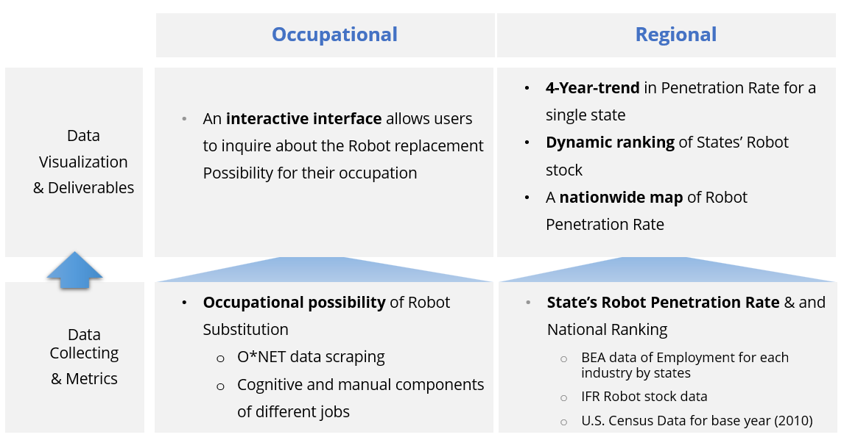
Project Flowchart

Slide 4

02
Occupational
Perspective
Web Scraping
+
Calculate Robot Replacement Rate
of Occupation
Source of the picture: https://www.ted.com/playlists/642/what_happens_when_the_robots_take_our_jobs

Slide 5
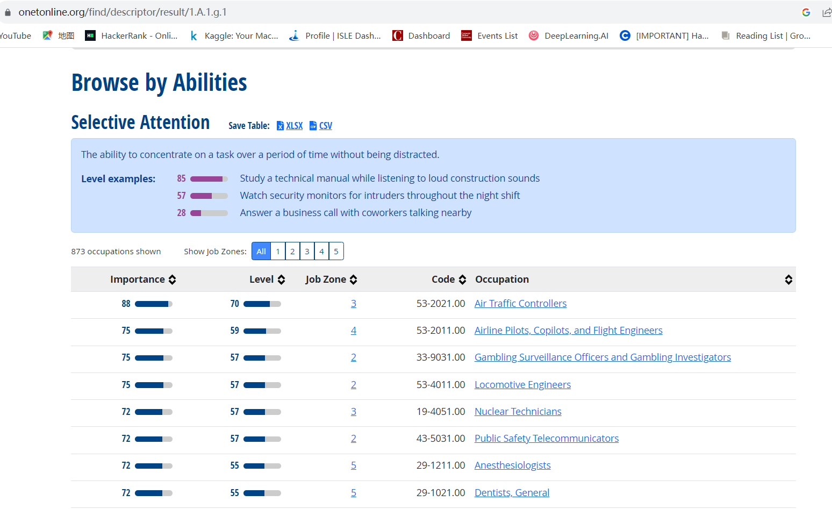
O*NET Occupational Skills Scores Scraping
Iterate over all the possible URLs
Find “table” in HTML code and store the tables in CSV files.

Slide 6
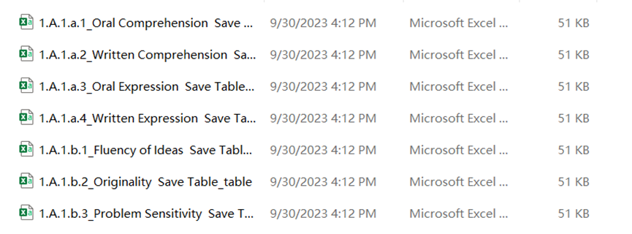
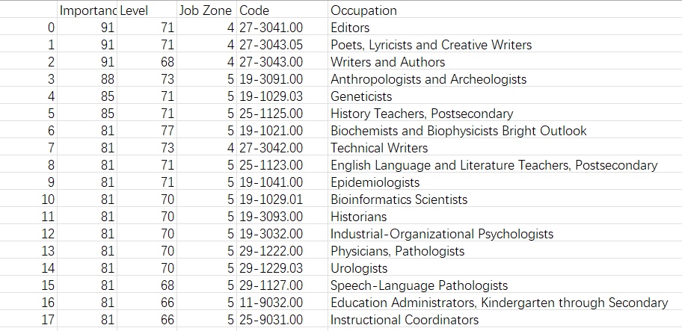
Data Collected from O*NET website
CSV files named with different abilities
Every file contains
the importance score of one ability for different occupation

Slide 7
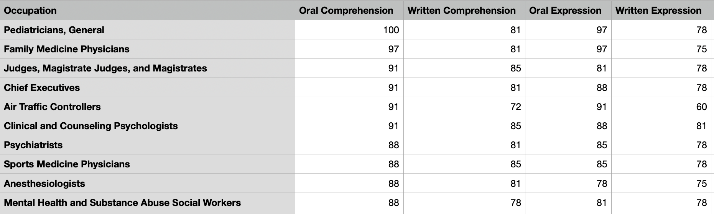
Merged O*NET Data
847 Occupations * 52 Skills Scores:

Slide 8
Replacement Skills
Dynamic Flexibility
Speed of Limb Movement
23
Trunk Strength
Gross Body Coordination

Slide 9
Non-Replacement Skills
Inductive Reasoning
Originality
29
Fluency of
Ideas
Deductive Reasoning

Slide 10
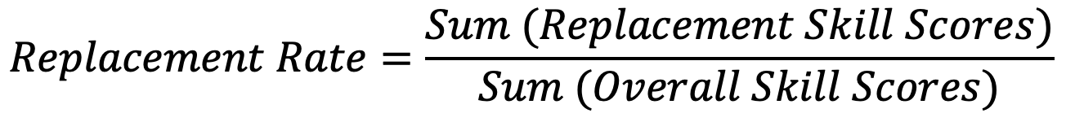
Computation
Higher number of physical skills required than cognitive skills
Higher Importance Scores of Physical Skills
Greater
Replacement Rate

Slide 11
Replacement Skills
Education Training
Finance
16
Manufacturing
Health Services

Slide 12

Application: Replacement Rate Checker

Slide 13
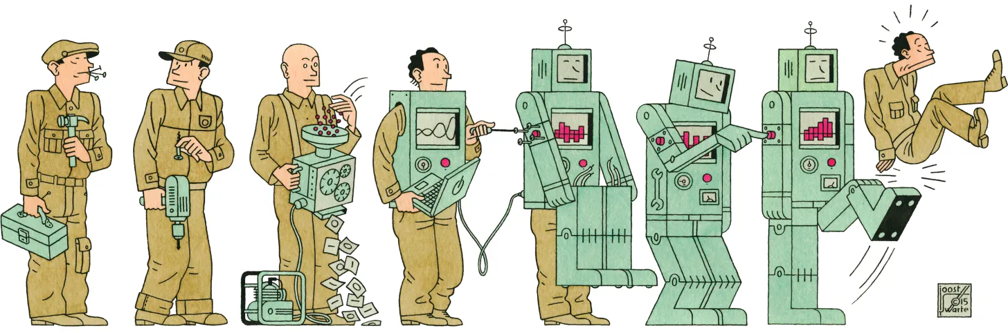
03
Regional
Perspective
Web Scraping | Data Cleaning
+
Robot Penetration Rate Calculation
Source of the picture: https://www.technologyreview.com/2015/06/16/11184/who-will-own-the-robots/

Slide 14
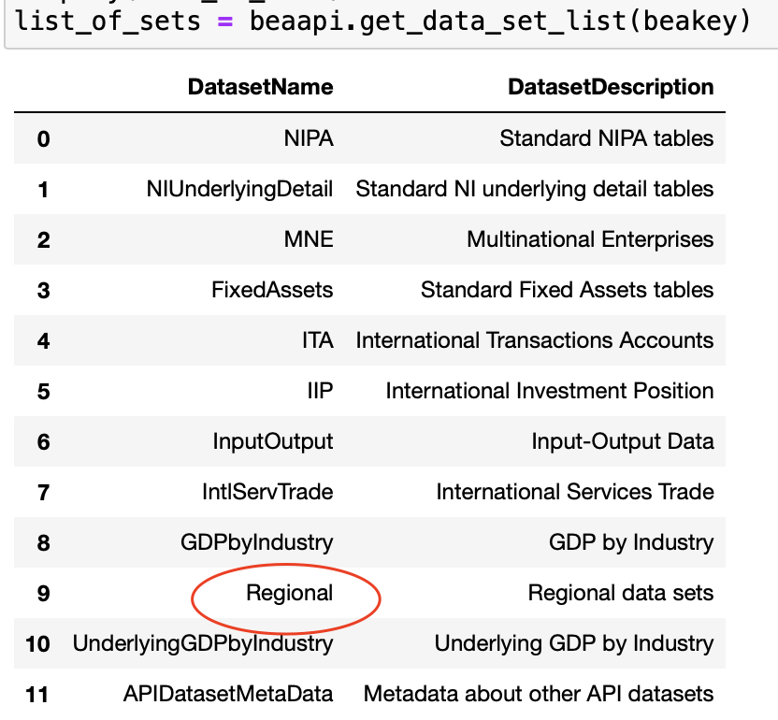
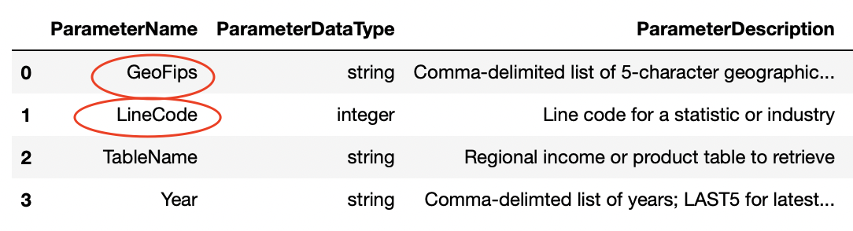
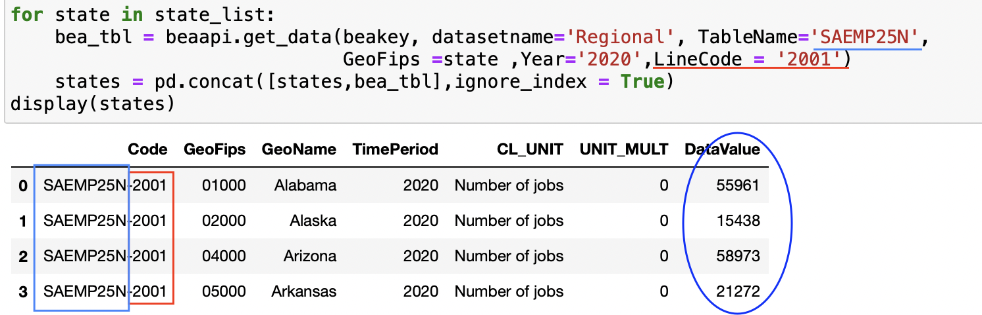
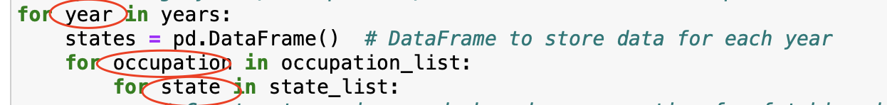
Retrieving Employment Data: Bureau of Economic Analysis (BEA) API
[SAEMP25N]
Total full-time and part-time employment by NAICS industry
GeoFips: State
LineCode: Industry
Year
Dataset: Regional
Loop: Year, Industry, State

Slide 15
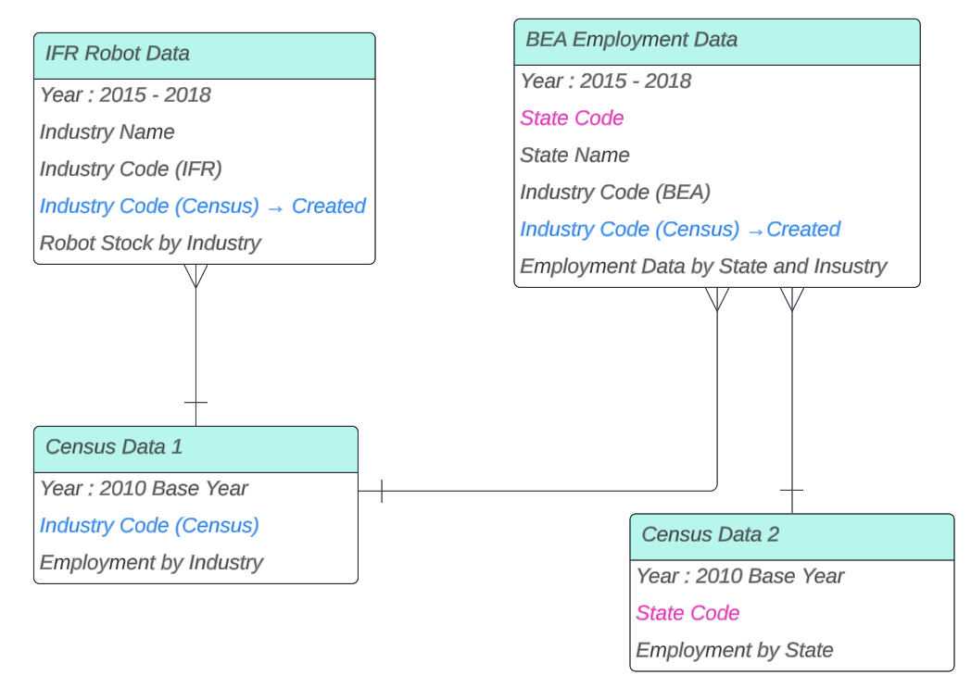
Data Cleaning
— merge data with different sources

Slide 16
Data Cleaning
— merge data with different sources
Match
these three data
using the industry code.
We manually create a “bridge” between them.

Slide 17
Data Cleaning
— merge data with different sources
Use state code to Match the BEA data with Census data.

Slide 18
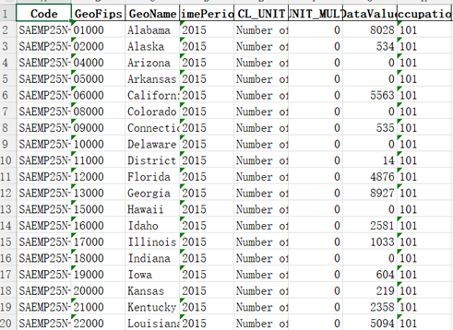
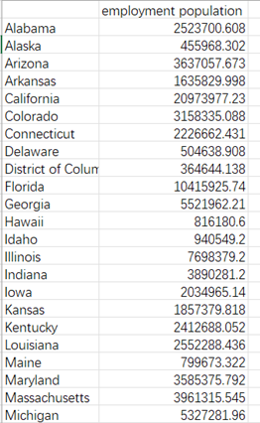
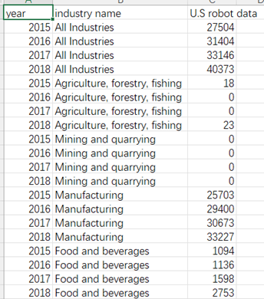
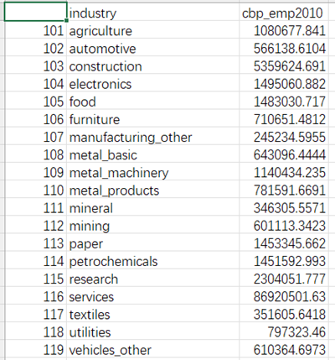
Data Cleaning
— merge data with different sources
The Outcome: From four files of data…

Slide 19
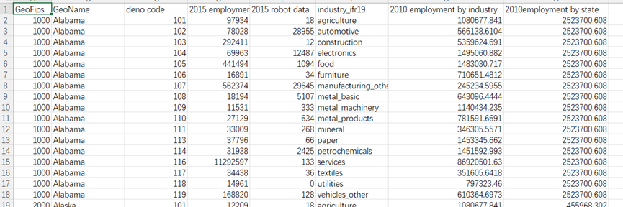
Data Cleaning
— merge data with different sources
The Outcome: From four files of data to one CSV file that is ready to be calculated!

Slide 20
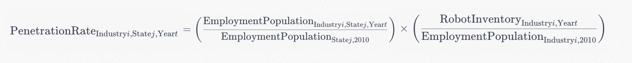

Robot Penetration Calculation

Slide 21
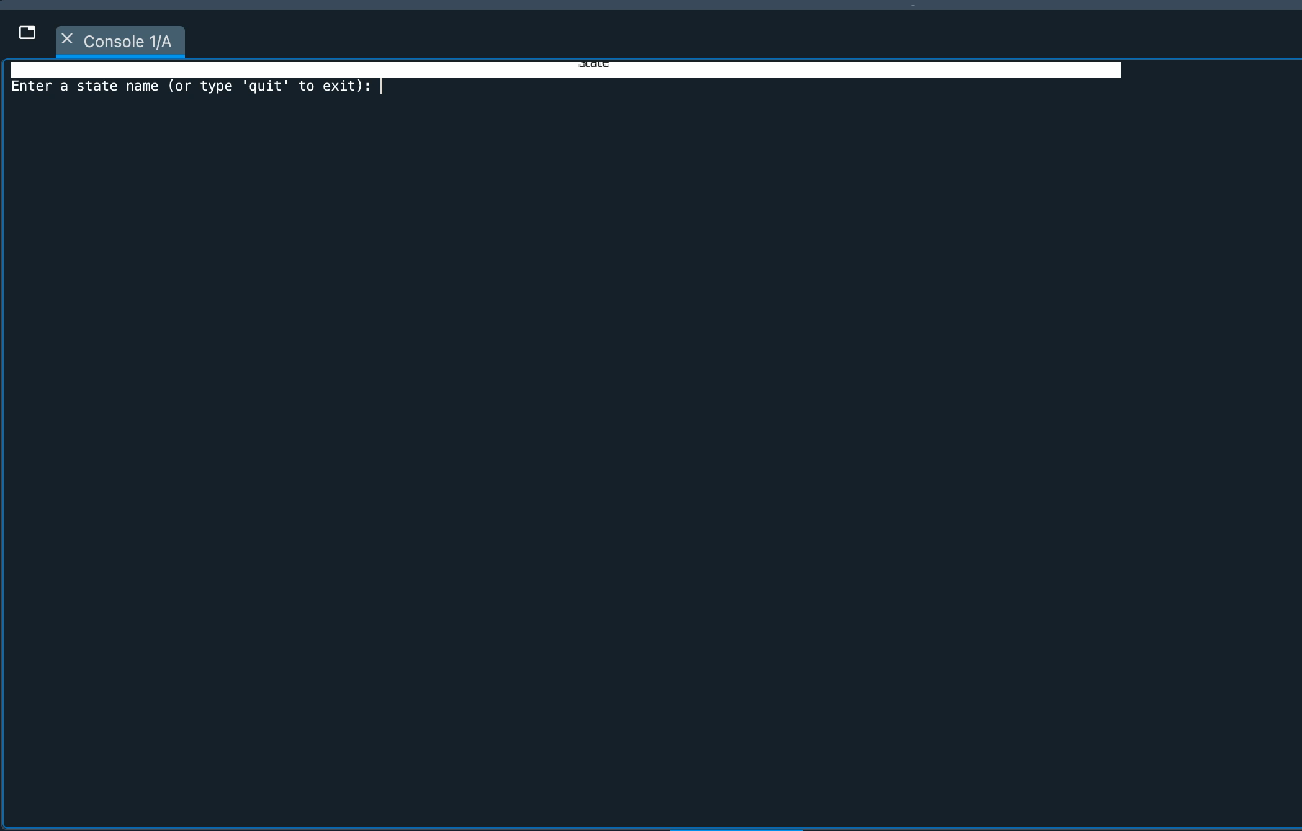
Application: Penetration Rate Ranking and Track 4-Year Trend
Input
State
Year
Output
Penetration rate
Histogram of penetration rate for all states, with emphasis on the selected state
Line graph comparing the penetration rate over four years for the selected state

Slide 22
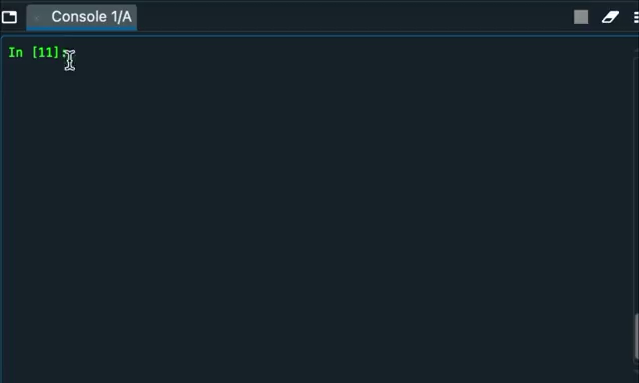
Application: Interactive Map
Input
Year
Industry
Output
Interactive Map of penetration rate across states for the input year + industry
Normalized penetration rate 0-1, from blue (low) to red (high) -> compare within the certain industry
Hover over the point -> show exact normalized penetration rate

Slide 23
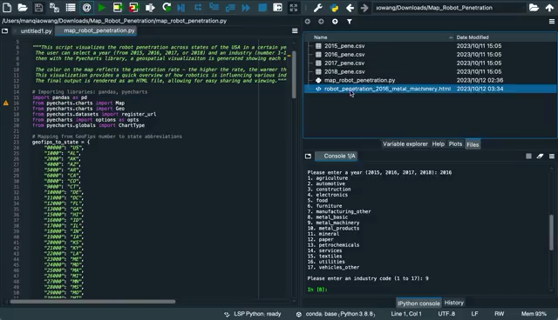

Slide 24




2
Source of the picture: https://www.flickr.com/photos/katy_tresedder/4902216441/

